Slide 1
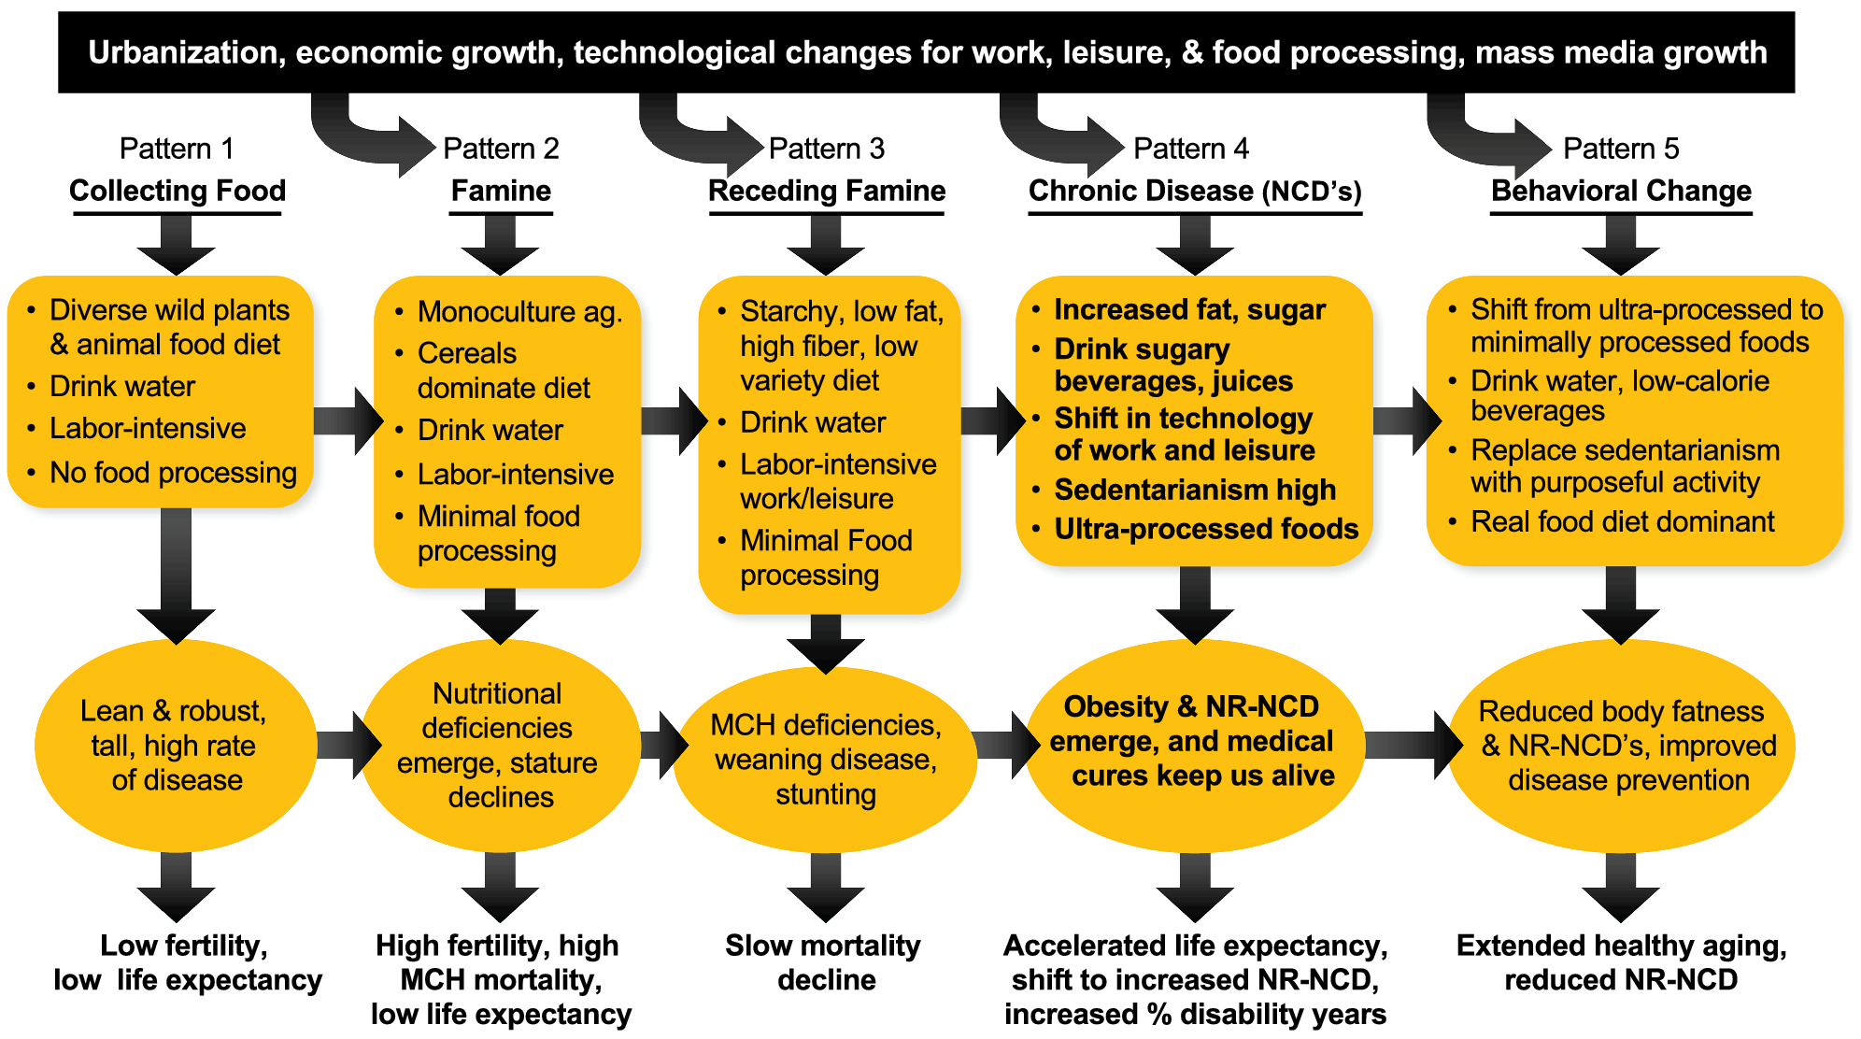
The nutrition transition to a stage of high obesity and noncommunicable disease prevalence dominated by ultra‐processed foods is not inevitable
Obesity Reviews, Volume: 23, Issue: 1, First published: 10 October 2021, DOI: (10.1111/obr.13366)
Notes:
Stages of the nutrition transition
IF THIS IMAGE HAS BEEN PROVIDED BY OR IS OWNED BY A THIRD PARTY, AS INDICATED IN THE CAPTION LINE, THEN FURTHER PERMISSION MAY BE NEEDED BEFORE ANY FURTHER USE. PLEASE CONTACT WILEY'S PERMISSIONS DEPARTMENT ON PERMISSIONS@WILEY.COM OR USE THE RIGHTSLINK SERVICE BY CLICKING ON THE 'REQUEST PERMISSIONS' LINK ACCOMPANYING THIS ARTICLE. WILEY OR AUTHOR OWNED IMAGES MAY BE USED FOR NON-COMMERCIAL PURPOSES, SUBJECT TO PROPER CITATION OF THE ARTICLE, AUTHOR, AND PUBLISHER.

